Slide 1
OUR MEETING WILL BEGIN SHORTLY
Don’t get nervous….
OUR SESSION WILL BEGIN SHORTLY
HUGE Announcement at the end for ALL attending guests !!!

Slide 2




Are you living life on your own terms?
Are YOU Reaching Your Financial Goals?
Are YOU Ready to Create Financial Freedom for YOU and Your Family?
What if Time and Money were no longer an issue?
HOW WOULD YOU SPEND IT ?

Slide 3




How often would you shop?

Slide 4


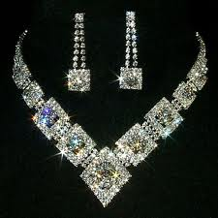
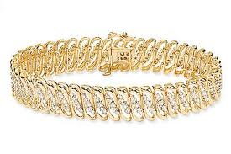

What would you wear?

Slide 5




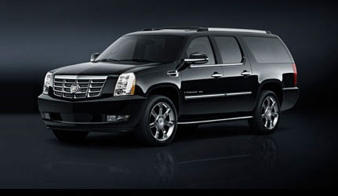
What would you drive?

Slide 6





Would you go cruising?

Slide 7

Where would you spend...
your next vacation???
Notes:
7

Slide 8


Slide 9


Slide 10


Slide 11

How would you live?

Slide 12


Slide 13



In Grand Style?

Slide 14
THE COMPANY
    Who We Are
    What We’re About

Slide 15


Slide 16

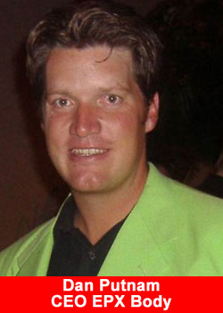
The Founder
EPX Body was founded by Dan Putnam, a highly successful network marketer with an impressive career.
EPX Body is headquartered in Layton, Utah and is fully launched and primed for expansion.
As you’ll find in most cases, MLM company owners who were once actually distributors build far better companies, for both affiliates and customers
EPX Body really shows what can be done when the games are thrown out the window.

Slide 17


Slide 18

***What Are the EPX Body Products?***
EPX Body has 8 outstanding products in it’s lineup that are sure to impact your health in a majorly beneficial way.

Slide 19
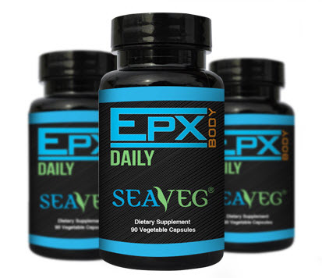
Here are some of the amazing benefits of
EPX Body Daily
Promotes Healthier Skin
May lower cholesterol levels
Helps fight allergies
Helps relieve stomach disorders
Helps support liver functionality
Helps fight free radicals
Known to stabilize blood sugar
May inhibit blood clotting
Used to assist in weight loss
Inhibits uptake of heavy metals
Used to remove toxins & heavy metals

Slide 20
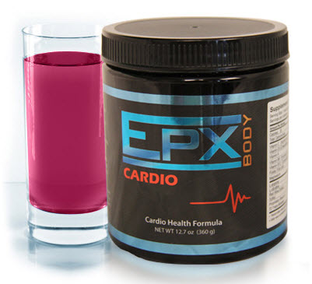
EPX Cardio
Improves cardiovascular health and reduces stress on the heart
Helps regulate blood pressure, lowers cholesterol & improves circulation
Improves diabetes and reverses related damage
Speeds recovery time after surgery and decreases infections
Builds lean muscle and improves muscle performance
Promotes healthy sexual function, libido, and performance
Improves memory and enhances cognitive functions
Boosts the immune system and overall health
Facilitates weight loss and alleviates obesity
Preserves bone density and improves osteoporosis
Improves outcome of cancer treatment
Prevents and heals hemorrhoids, painful urination, and IBS
Alleviates cirrhosis and helps to detoxify the liver
Helps offset lung damage caused by smoking

Slide 21
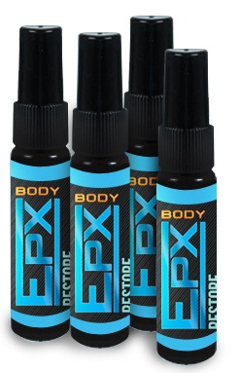
EPX RESTORE
Fast Acting Benefits Reported
(1 to 3 weeks)
• Stress reduction
• Increased sexual vitality
• Increased physical vitality
• Ability to concentrate better
• Greatly improved sleep & energy
• Shortened recovery after workouts
Slow Acting Benefits Reported (6 weeks or more)
• Optimize weight
• Helps balance cholesterol
• Increased feeling of well being
• Supports healthy, pain free joints
• Improved memory and brain function
• Enhances cellular & liver detoxification
• Cellulite melting off thighs and buttocks

Slide 22
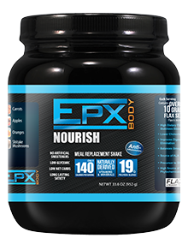
The World’s Most Perfect 2-Minute Meal
Accelerates Fat-Loss with the aid of the Essential Omega Fatty Acid – FLAX SEED
Includes an all-natural blend of the recommended daily fiber
Each serving is designed with the phyto-nutrient base of 4.5 servings of Fruits & Vegetables
Perfect for strength athletes, endurance athletes, fitness enthusiasts and any health-conscious, active individual
Improves muscle performance in athletes
Accelerates muscle recovery when used to help meet your daily protein requirements

Slide 23

EPX Body Burn
Suppresses Appetite
Speeds Weight Loss
Increases Energy
Burn Fat Fast
Shrinks Belly Fat
Improves Overall Health

Slide 24

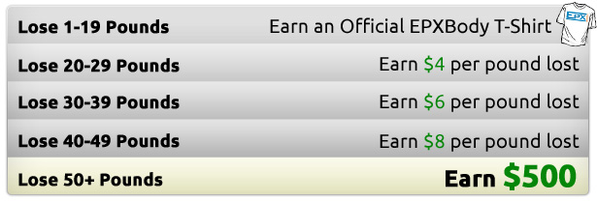

Slide 25

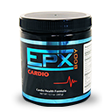



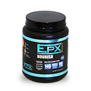
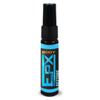

You have 3 options to get started with EPX
$39.95
Promoter (40cv)
$199.95
Trainer (200cv)
$399.95
Executive (400cv)
NO marketing kit required to buy.
NO monthly website fee

Slide 26

Retail Income
Paid weekly,
No “Qualifications”
1
Earn 40%* on every customer order online.
EPXbody gives you a full E-commerce business.
We do the shipping for you.
We give 30 days satisfaction money-back guarantee to customers.
You just send your customers to your EPXbody website to purchase products
This Presentation is an overview of EPXbody Compensation Plan . *Bonus is based on the CV of the order
The complete plan details may be found in the www.EPXbody.com login area.
This is for training purposes only. EPXbody makes no claim or guaranty of income.

Slide 27

Retail Income:
Monthly Income Potential
Sell $39.95 single product to 200 customers
40% of 40cv = $16
x 200 Customers = $3200 monthly
or
Sell $39.95 single product to 1000 customers
40% of 40cv = $16
x 1000 Customers = $16000 monthly
This Presentation is an overview of EPXbody Compensation Plan . *Bonus is based on the CV of the order
The complete plan details may be found in the www.EPXbody.com login area.
This is for training purposes only. EPXbody makes no claim or guaranty of income.

Slide 28

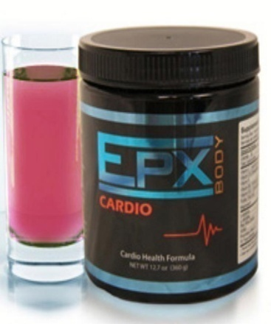

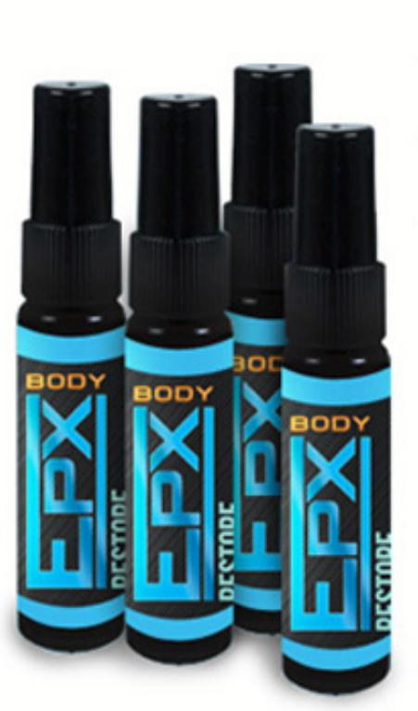

2
Paid weekly,
No “Qualifications”
Fast Start Bonus –
Earn 30% - 40% on your sponsor Rep’s
Initial product order & Fast Start Pack**
$39.95 (40cv) single product order X 40%** = $16
$199.95 (200cv) Fast Start Pack X 30%** = $60
$399.95 (400cv) Fast Start Pack x 30%** = $120
** Fast Start Bonus is based on the CV of the order.
This Presentation is an overview of the EPXbody Compensation Plan only. The complete plan details may be found in the www.EPXbody.com opportunity area. This is for training purposes only.
EPXbody makes no claim or guaranty of income.

Slide 29
Fast Start Bonuses:
Weekly Income Potential
Sell $39.95 single product to 4 new Rep per week
40% of 40cv = $16
x 4 Reps = $64 per week
or
Sell $199.95 Fast Start Pack to 4 new Rep per week
30% of 200cv = $60
x 4 Reps = $240 per week
This Presentation is an overview of EPXbody Compensation Plan . *Bonus is based on the CV of the order
The complete plan details may be found in the www.EPXbody.com login area.
This is for training purposes only. EPXbody makes no claim or guaranty of income.

Slide 30
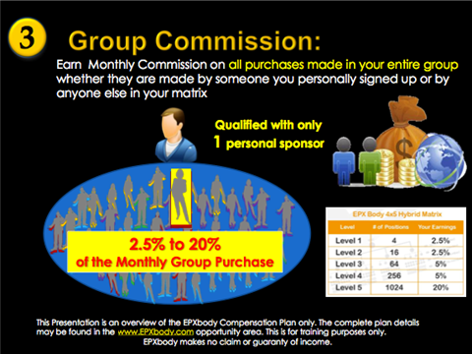

Slide 31
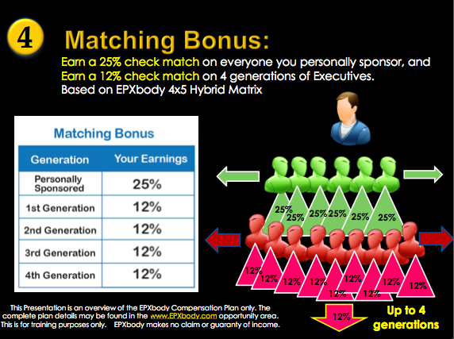

Slide 32
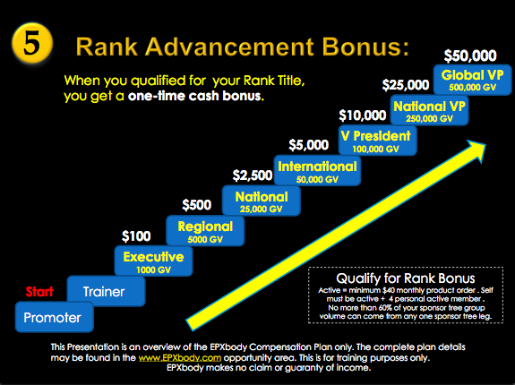

Slide 33


Slide 34


Slide 35
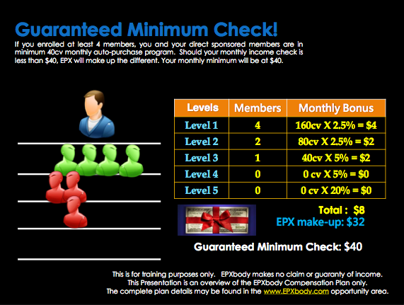

Slide 36

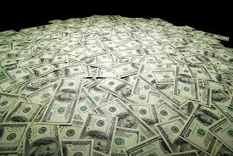

Slide 37
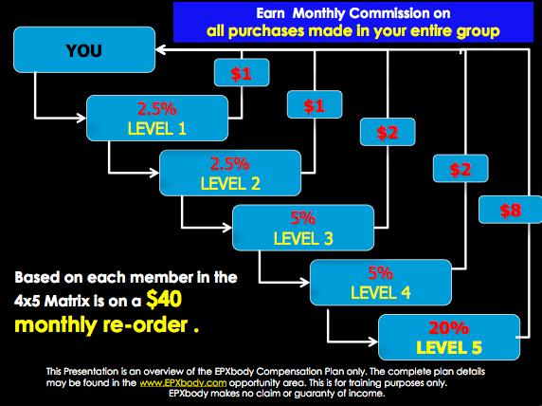

Slide 38
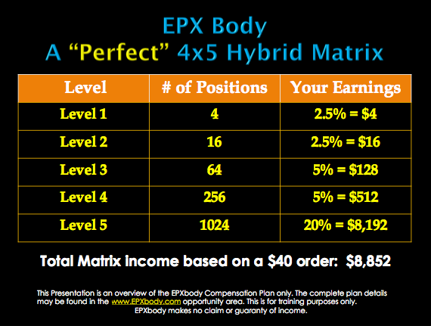

Slide 39
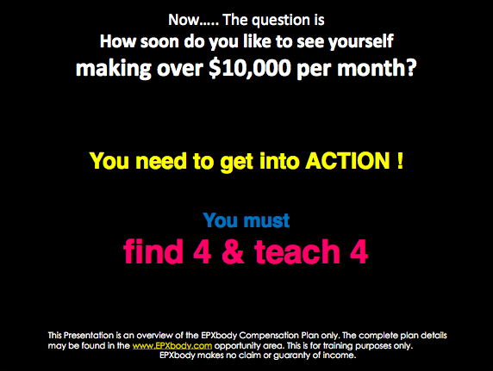

Slide 40
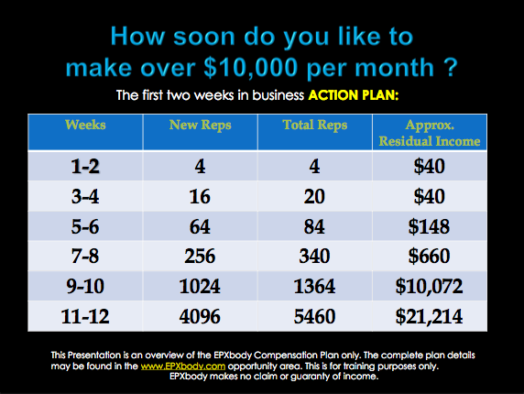

Slide 41
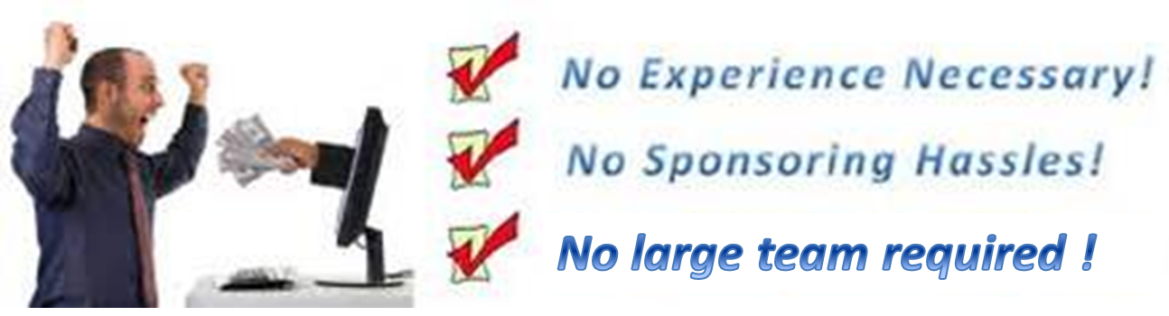



So Why Does EPX Stand Out?
EPX members can purchase leads through the company. These will be highly qualified targeted leads who would have been shipped free product and DVD & have been placed in your downline.
No more harassing friends or family to join your team.
Finally, a company that got it right

Slide 42

Henry Ford

Slide 43


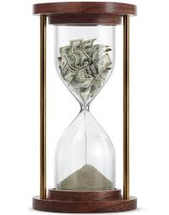

IF NOT THIS –
WHAT ?
IF NOT NOW -
WHEN?
IF NOT YOU -
WHO?

Slide 44


What Will You Do?
Nothing
Circumstances Stay The Same
Exchange Hours for Wages
Always wonder “What If”
Join EPX Body
Circumstances Change
Unlimited Income Potential
24/7 Business
Ongoing Support
No Experience Required
Notes:
44

Slide 45
BIG ANNOUNCMENT
ALL GUESTS ATTENDING
who join EPX within 2 days of this presentation will get a chance to take part in our prize draw to win a ….

Slide 46
FREE Caribbean Cruise !!

Slide 47


Get Back To The Person Who Shared The Presentation With You And Let Them Know You’re Ready To Get Started Right Away!!!
Brought to you by
Ultimate Power Team
It’s Time To Live Life On Your Own Terms !!

